Slide 1
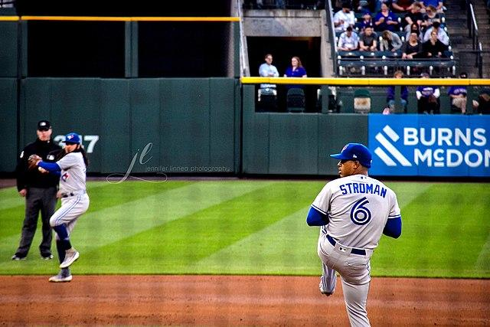
SAL 603: Final Presentation
Demonstrating the effect of speed and pitch movement on strikes
Jason Weinberg
Notes:
Hi! Thanks for watching and following along with the presentation, we’re gonna be researching
the relationship between speed and break / movement on strikes in MLB, then after that we’re gonna use some of The data we found to look into some cool stats regarding whiff rates, individual pitchers and which of their pitches were Basically unhittable last season

Slide 2
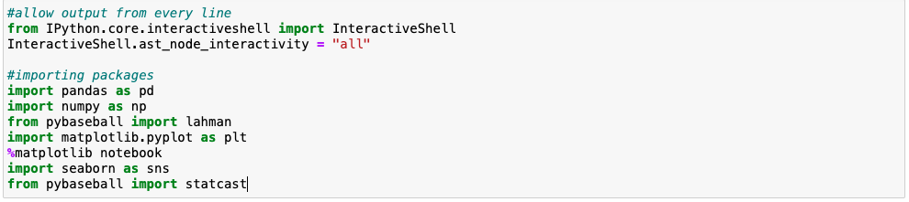
Demonstrating the effect that release speed and pitch movement have on strikes
Importing packages
Using statcast data from the 2023 MLB season
Notes:
Starting off by importing all of the packages, pandas, numpy, matplotlib, py-plot, seaborn, and most importantly statcast
We use statcast data from the 2023 mlb season, you can see we’re gonna be using those dates to encapsulate the
First pitch of opening day through the last pitch of the world series

Slide 3
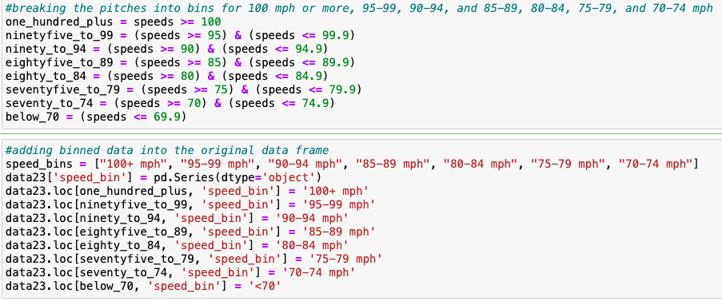
Demonstrating the effect that release speed and pitch movement have on strikes
Notes:
So getting into the actual research, we’re gonna start by separating the data into bins
The bins are 70 mph and below through 100 mph and above, separating into bins by 5 mph
Eventually we’re gonna use these bins to find amounts of pitches thrown and their relations to strikes

Slide 4
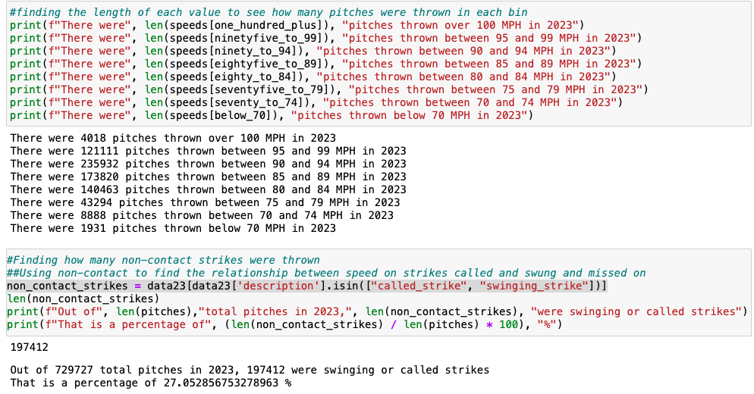
Demonstrating the effect that release speed and pitch movement have on strikes
Notes:
Finding the length of the values in each bin to see how many pitches were thrown at each of the speed
Then we defined non contact strikes by using is in to find called or swinging strikes, want to note
That we’re using the called and swinging strikes because foul balls, missed bunts, etc won’t help show the relationship of speed or pitch movement
Foul balls happen too frequently and would interfere with the data
used the length of non-contact strikes to find the amount of strikes that were caught by the catcher, and then found the percentage of the total

Slide 5
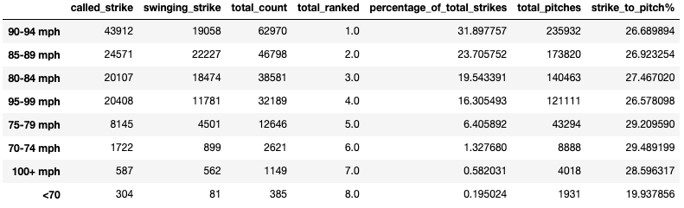
Overall DF showing data from 2023: Swinging and called Strikes, the sum of both, and ranking the sum.
What percentages each bin made up of the aggregate, the total pitches split up in bins
The last column is the percentage pitches thrown in each bin is a strike
For example, a pitch thrown over 90-94 MPH has a
## 26.6% chance to be a called or swinging strike

Slide 6
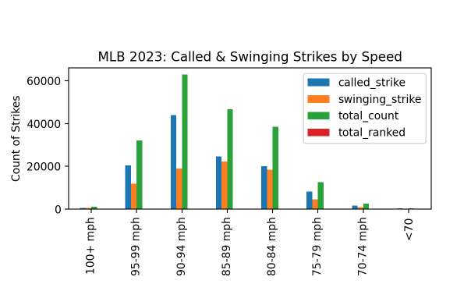
This visualization depicts the speed bins and their respective swinging, called, and total strikes

Slide 7
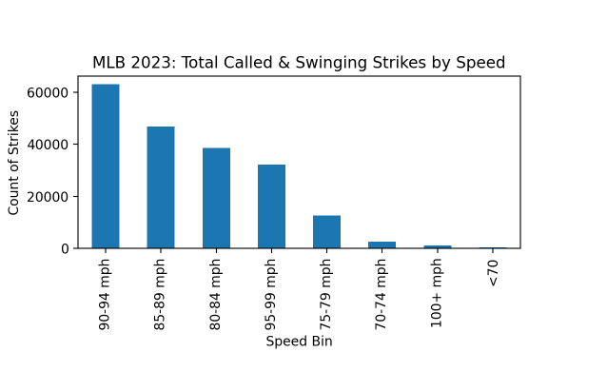
This chart visualizes the bins with their total count of strikes

Slide 8
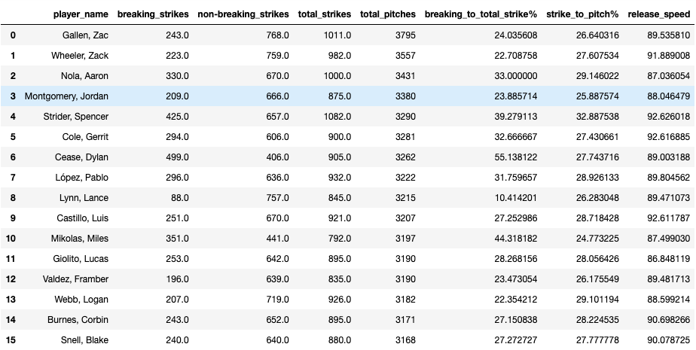

Slide 9
Data Frame (previous slide)
The data frame from the previous slide shows the 50 pitchers in MLB that threw the most pitches. You can see Zac Gallen, Zack Wheeler, Aaron Nola, and Jordan Montgomery all threw the most pitches they’re all from teams that went to either the world series or championship series so they pitched deep into October
This adds in the pitcher’s mean release speed from all of their pitches, what their strike percentage is, and how many breaking pitches make up their total strike percentage. Only a handful of guys are even above 90 in their mean release speed further proving from before its either not sustainable to continue to try to throw high speed pitches every time, or even pitches strictly with a lot of break. We’re learning that these guys need to mix it up to have success.

Slide 10
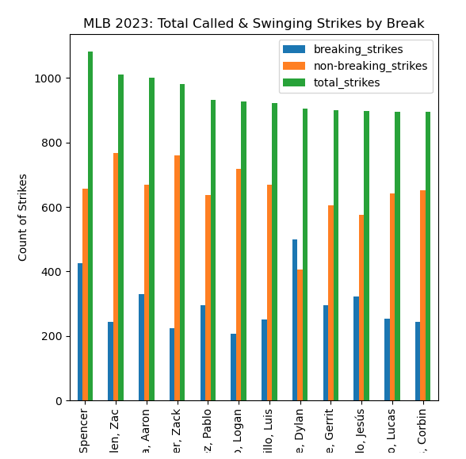
Top 12 pitchers and their respective breaking, non-breaking, and total strikes

Slide 11
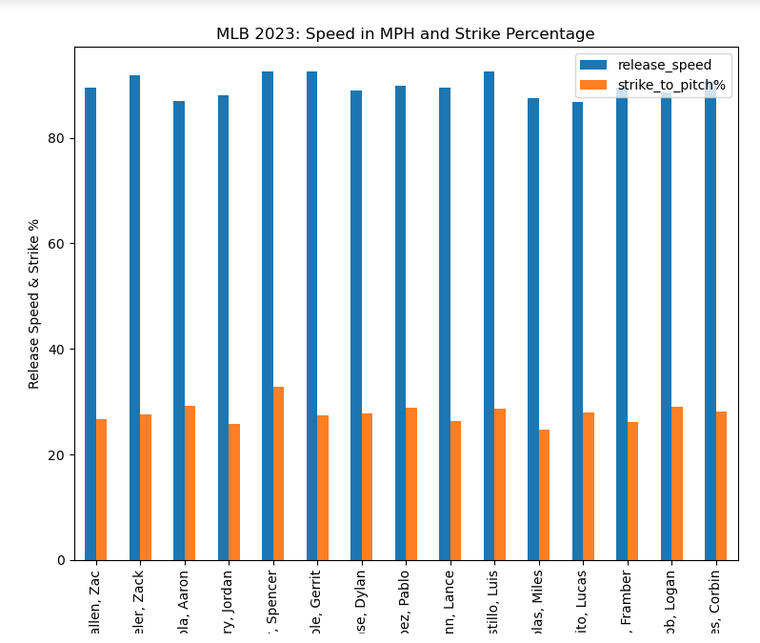
Top 12 pitchers and their respective release speeds and strike percentages

Slide 12
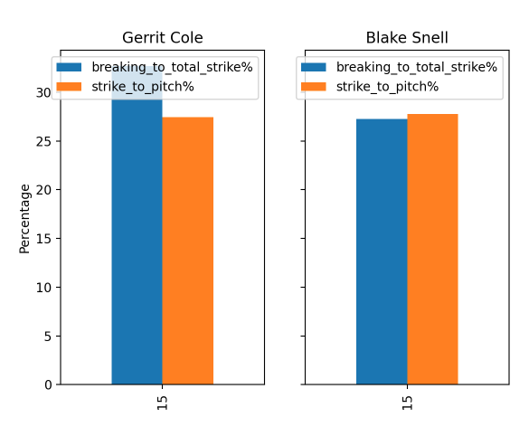
I pulled the stats for the two pitchers that won the cy young award last year, in Gerrit Cole of the Yankees and Blake Snell from the Padres, and visualized their data.
You can see Cole had way more breaking pitches as strikes compared to Snell, yet Snell threw a higher percentage of strikes.
The two best pitchers in the league don't show enough correlation between breaking pitches as a percentage of strikes To show significance and again further back up the need to mix it up to keep hitters off balance.

Slide 13
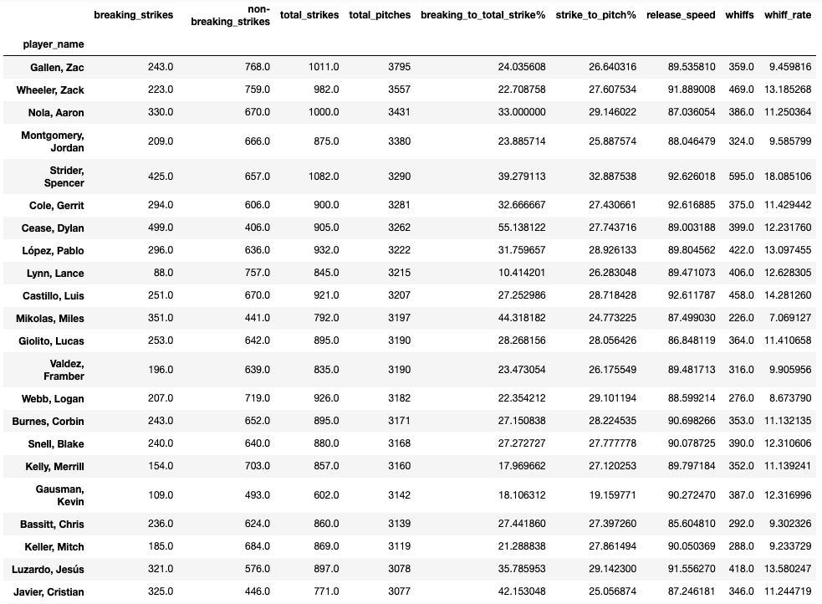

Slide 14
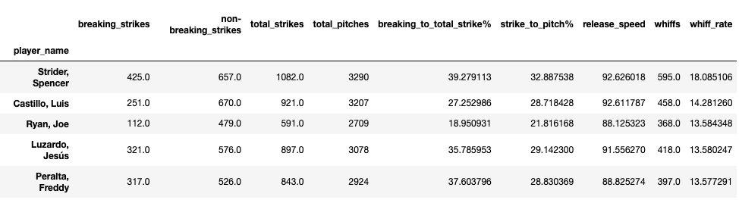
Data Frame (previous slide)
I now went on to look at whiff rates, counting the values for swinging strikes.
This Data frame Showed how many whiffs per pitches thrown each player had, to find their rate.
I wanted to highlight how incredible Spencer Strider’s 18% is, where nearly 1 in 5 pitches is swung and missed at.

Slide 15
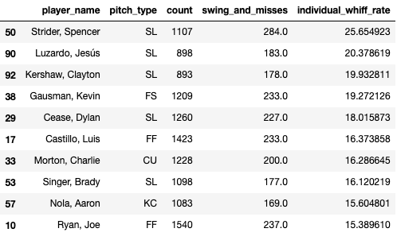
Further diving into whiff rates, we were able to find out which pitches are the toughest to hit in the league.
This data with the most thrown pitches and then the amount of whiffs there were leads us to the displayed data, where we find the individual whiff rate for each pitcher’s pitch, again noting that Strider’s slider has an amazing whiff rate of 25.6% which is hard to hit.
These show the ten best pitches in the league last year, which shows some great value for pitchers if they are in a spot where there are runners on and really can’t afford to get the ball put in play or need a strike out.

Slide 16
Main Takeaways
The research doesn’t display any statistical significance between speed or break and strikes. The data doesn’t signify any trends that are applicable to the rest of the league or anything that we can really find that would lead to a competitive advantage anywhere

